Slide 1
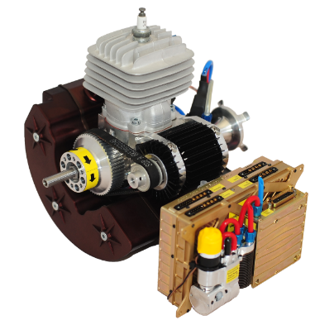
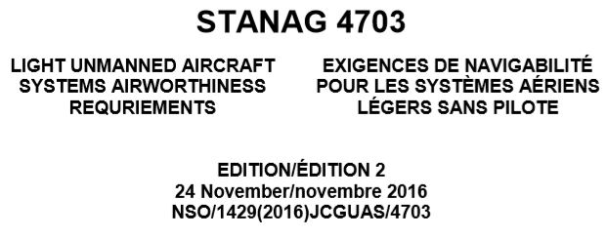
Market Trends for UAV propulsion systems
Gavin Brett, CEO, Currawong Engineering
Customers are requesting:
    Complete turnkey EFI propulsion system for ease of integration (quiet exhaust, starter/generator, power supply, isolation mount, cooling duct, harnesses, interface software)
    Propulsion systems that meet standards (MIL, Stanag)
      Endurance test modified FAR33
      Noise/vibration
      Environmental conditions (temperature, altitude/pressure, humidity etc.)
      Quadrotor with hybrid engine/electric systems

